Slide 1
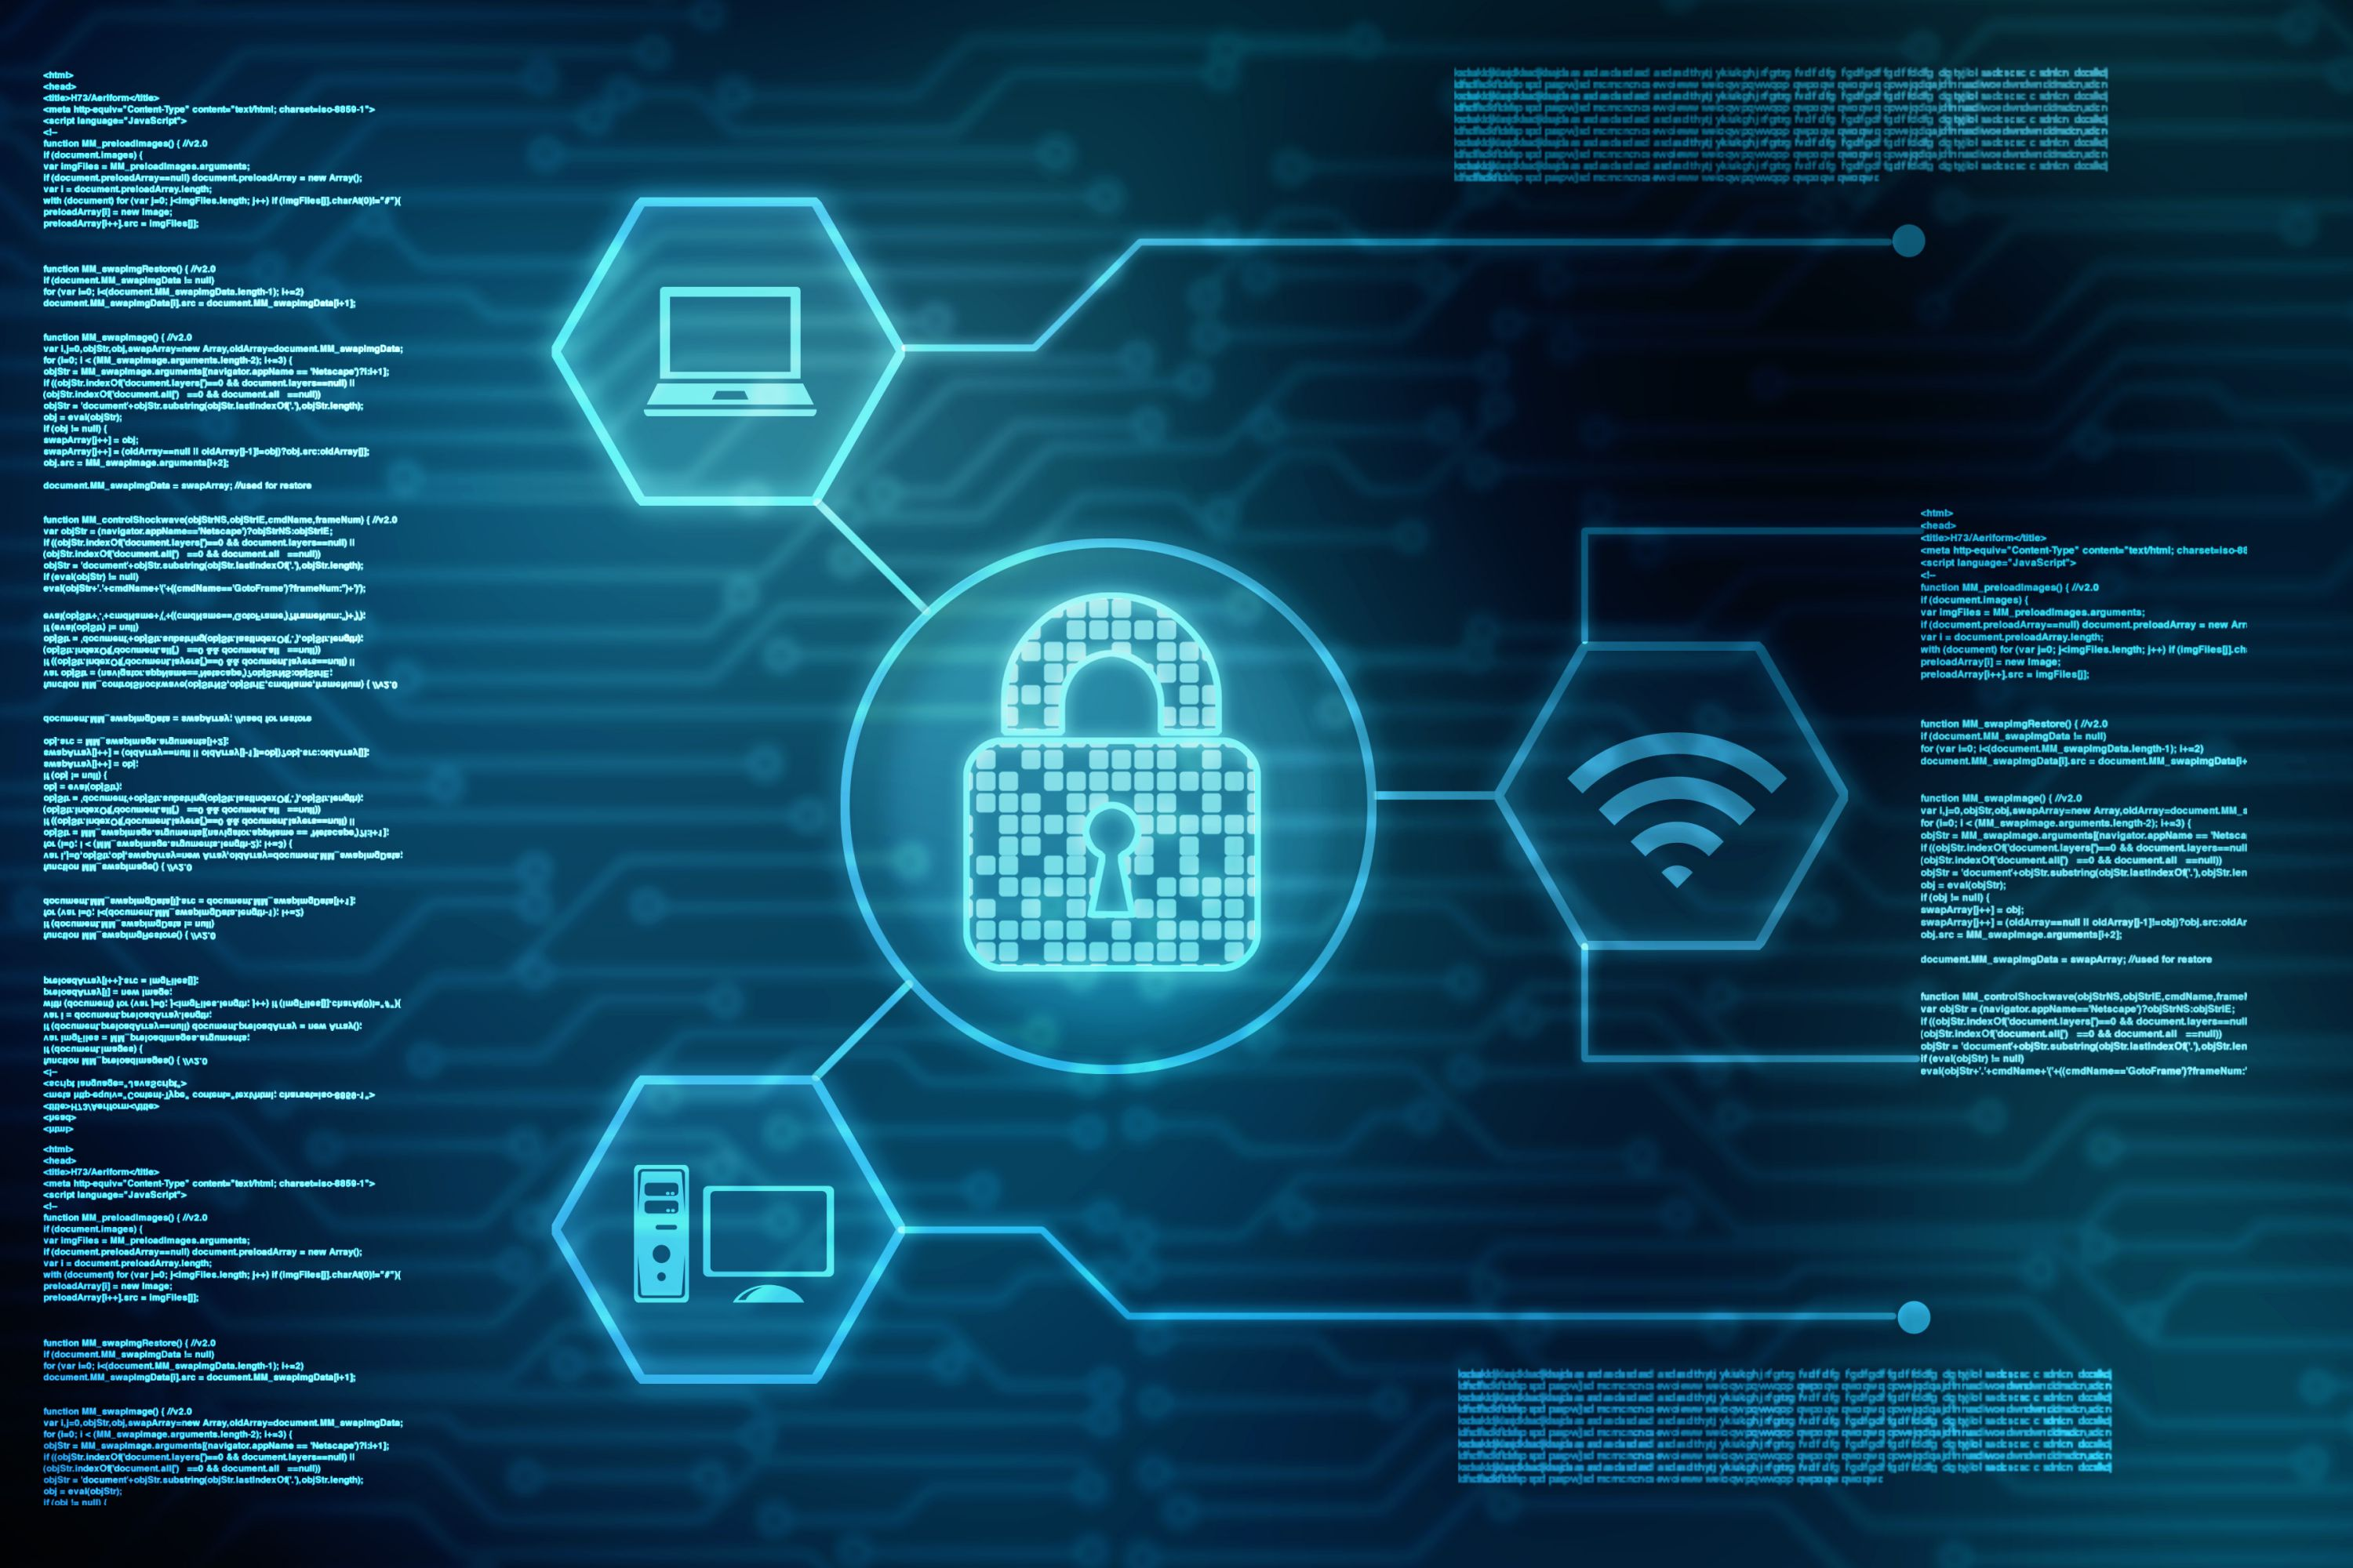
St. Clair County IT – Feb. 28, 2018
Computer Security
- St. Clair County Network-

Slide 2
Topics we will discuss
Malware, Viruses, Ransomware
Email
Web Browsing
Content Filtering
Passwords
Data Backup
New Computer Use Policy

Slide 3
Malware, Viruses and Ransomware
Malware – software that is intended to damage or disable computers
Can come from corrupt website
Sometimes there will be a false alarm stating that your computer is infected
Don’t call the number or click the link, call us immediately
Spyware – software that enables a person to see what you are doing on your computer without you knowing it
Can come from corrupt website
Piggybacked software installation
Browser add-ons – toolbars, additional search bars, etc.
Some spyware masquerades as antispyware
Notes:
Piggybacked software installation - just clicking yes on every window when installing software

Slide 4
Malware, Viruses and Ransomware cont.
Virus - a piece of code that is capable of copying itself and typically has a detrimental effect such as corrupting the system or destroying data
Computer viruses can infect your computer through email attachments, downloads from the internet or removable media (thumb drives)
Viruses can spread through the network via shared folders
Ransomware – a type of malicious software designed to block access to a computer system until a sum of money is paid
Typically comes through email as an attachment.
Once opened, the ransomware will lock files by encrypting them and you need the decryption key to unlock the files, which requires a substantial amount of money to acquire
Notes:
Speaking of thumb drives, if you ever find a thumb drive laying around, do not plug it into your computer to see what is on it. Get it to us and we can safely determine the contents and whether it is ok to use.

Slide 5
Email
You receive an email and you don’t recognize the sender or the email looks suspicious:
Don’t open the email or any attachments or click on any links
Delete the email
You get an email from FedEx or UPS about a package that you didn’t order
Don’t open the attachment
Delete the email
You get an email with a strange attachment, either from someone you don’t know or possibly someone you do know
Don’t open the attachment
Delete the email
Notes:
We all use email, but how can be more careful? Here are a few scenarios and how you should respond.
Email Spoofing – creation of email with a forged sender address
If you are hesitant about deleting an email that looks suspicious because you think it might be legitimate, you can call or email the sender to make sure. My thought are “better safe than sorry and if it is legitimate or important, they can resend the email.

Slide 6
Email cont.
You get an email requesting your username and password
Don’t ever send your username and password via Email
We will never ask for that information via Email
Don’t use your county email to sign up for things unless they are related to county business
We have a spam filter to try and block spam, but you can help decrease spam by not putting your email address out there
Notes:
When you sign up for things using your email address, it can be put on a list that is sold to companies that send out junk or spam emails.

Slide 7
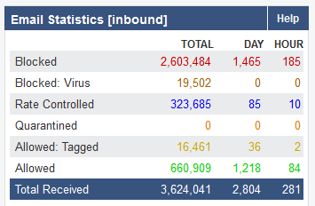
As of 2/20/2018 @ 2:53 PM – SPAM Filter was installed in July of 2016
Notes:
This doesn’t included emails between stclairco users. We have security measures in place to protect internal emails.

Slide 8
From: IT@stclairco.com
Subject: Change of Password Required Immediately
We suspect a security breach happened earlier this week. In order to prevent further damage, we need everyone to change their password immediately.
Please click here to do that:
Change Password
Please do this right away. Thanks!
Sincerely,
IT
Notes:
Phishing experiment. We used a free tool to send out a phishing email to a limited number of users.

Slide 9
Social Engineering Experiment
Out of 53 employees that received this email…
17 people (33.3%) clicked on the link

Slide 10

Web Browsing
Use caution when browsing the internet
If you use a search engine, most of the top search results are ads and have a small line of text denoting this
Change your homepage from the default MSN or Yahoo
These sites contain many ads and those ads can be easily corrupted
Avoid accessing personal Social Media websites on the county network
Most of the time, your job will not cause you to access a corrupt website
Be cautious when clicking on links in webpages, searches and emails
Notes:
If your department has a social media site that is used for business related functions, of course you can access it. Companies know these sites are frequented and that is why there are so many ads, and these ads can be compromised

Slide 11
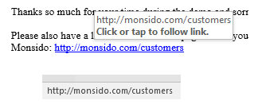
Web Browsing cont.
Notes:
In emails and in most web browsers, you can hover over the link and it will show you at the bottom what site you are going to. As a good rule of thumb, if the site doesn’t match the link, then it probably isn’t a legitimate site. There are some exceptions when a tool is used to shorten a link. I noticed that the ACCA uses this tool in their emails.

Slide 12
Content Filtering
The county has a network firewall/content filter device
This device has rules that allow access in and out of our network
We currently have it set to block things like adult content, drugs, etc., but it isn’t locked down tight
We have the capability of setting up different profiles for each department
In the near future, we will be getting with each department head to determine what, if any, content restrictions need to be implemented for your department
Notes:
State agencies, this doesn’t apply to you as your internet access is through AOC

Slide 13
Passwords
Don’t share your passwords with anyone!
Don’t write your passwords on sticky notes and attach them to your monitor or bulletin board!
Don’t use the exact same password for everything
Password1 – P@ssw0rd1 – p@SSworD1 – Password2
Although it is tempting to use a simple password that’s easy to remember, those passwords are easy to guess or crack
There are apps for your phone and also applications for your computer to safely keep up with your passwords
Please ask us before using any application so we can verify that it is safe

Slide 14
Data Backup
In the unlikely event that you get infected, or your hard drive crashes, you can recover your files if you have a backup
We backup all county servers, but we do not backup data on desktops or laptops
Depending on the amount of data you have, you can use a thumb drive or an external hard drive
This backup drive should not stay connected to your computer at all times.
If your computer gets infected, the external storage device could be infected as well and then your backups are useless

Slide 15
New Computer Use Policy
We have developed an updated computer use policy that has been adopted by the County Commission – Policy #57
This will be on the county website this afternoon
Please have each employee read this policy
After they have read it, the last page needs to be printed and signed by each employee and turned into our HR Specialist, Sandra Wolfe
Your work computer is not your personal computer and shouldn’t be used as such
Your computer is a tool to allow you to accomplish your job

Slide 16
Questions…..

Slide 17
Contact information
John Myers
IT Technician
jmyers@stclairco.com
205-594-2496
Glenn Morgan
IT Manager
gmorgan@stclairco.com
205-594-2495
To submit a ticket by email:
helpdesk@stclairco.com
www.stclairco.com/technology

